Slide 1


Digital Annealer for High-Speed Solving of Combinatorial Optimization Problems and Its Applications
From: 2020 25th Asia and South Pacific Design Automation Conference (ASP-DAC)
Author: Satoshi Matsubara, Motomu Takatsu, Toshiyuki Miyazawa, Takayuki Shibasaki, Yasuhiro Watanabe, Kazuya Takemoto and Hirotaka Tamura
(Technology Development Project, Digital Annealer Unit)
(Fujitsu Laboratories LTD)
Presenter: Ting-Yi Wu
Instructor: Jie-Hong Roland Jiang
ALCom Lab

Slide 2
Outline
Introduction
Operating principle
Evaluation Results
Application Examples
Conclusion
Reference

Slide 3
i. INtroduction

Slide 4
Introduction
A Digital Annealer (DA) is a dedicated architecture for high-speed solving of combinatorial optimization problems mapped to an Ising model.
Fully coupled bit connectivity
High coupling resolution
Uses Markov Chain Monte Carlo as a basic search mechanism
Accelerated by the hardware implementation of multiple speed-enhancement techniques
Parallel search
Escape from a local solution
Replica exchange
Offered as a cloud service using a second-generation chip operating on a scale of 8,192 bits

Slide 5
Introduction (cond.)
As Moore's Law, the performance improvement of general- purpose processors is slowing down
Specific computing that improves the performance by applying dedicated hardware and algorithms to specific application domains is gaining attention.
However, even the slightest change in the application could lead to a system needing to be redesigned.
Having a compelling range of applications
Allowing specialization to achieve significant performance gain
Combinatorial optimization problem
Ising model

Slide 6
Ising model
The optimization methods using the Ising model:
Annealing
Quantum or classical computation
Guaranteed to provide a solution in ideal situations, but its operation requires sensitive hardware control
E.g. D-Wave Systems
Nonlinear oscillation
Having physical devices or not
E.g. Coherent-Ising Machine and Simulated Bifurcation

Slide 7
Ising model
Statistical model representing the spin
Atomic spins in two states(+1 or -1)
+1 : up
-1 : down
Two procedures:
Anneling:
State transition that lowers the local energy by the interaction with adjacent spins
Random flip:
A stochastic state transition to help escape from local minima

Slide 8
iI. Operating principle

Slide 9
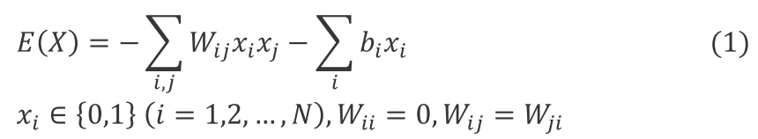
Ising energy function search method
The DA searches the lowest value of the energy function expressed in binary quadratic form on the basis of the Markov Chain Monte Carlo (MCMC) method.
The energy function:
With fully coupled connectivity and high resolution of coupling coefficient, a wide variety of combinatorial optimization problems expressed in Ising models can be easily mapped to the DA.

Slide 10
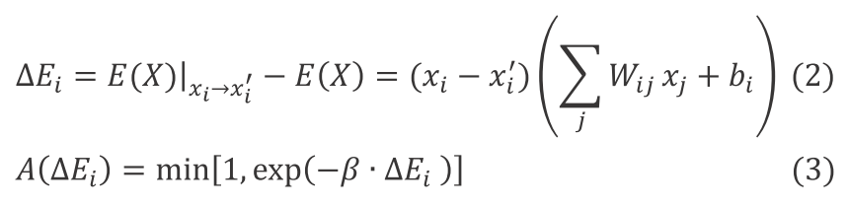
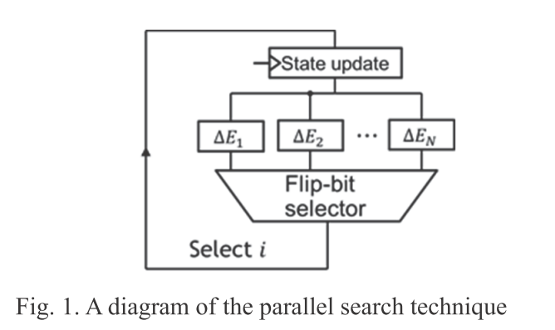
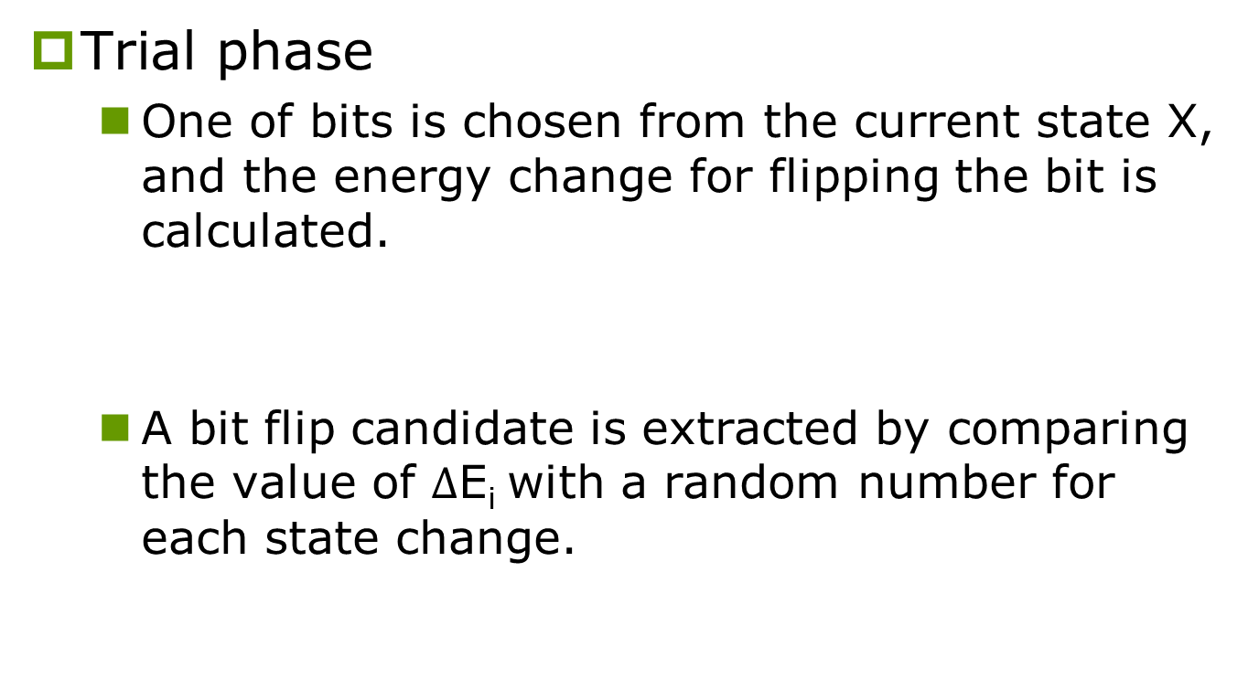
Speed-up by parallel search
Trial phase
One of bits is chosen from the current state X, and the energy change for flipping the bit is calculated.
A bit flip candidate is extracted by comparing the value of $Δ$E_{i} with a random number for each state change.

Slide 11
Speed-up by parallel search
Update phase
The flip-bit selector selects one bit to be flipped and updates the value of x_{i}.
If there is no candidate to update, the update selector outputs a flag value of “0” and returns to the trial phase.

Slide 12

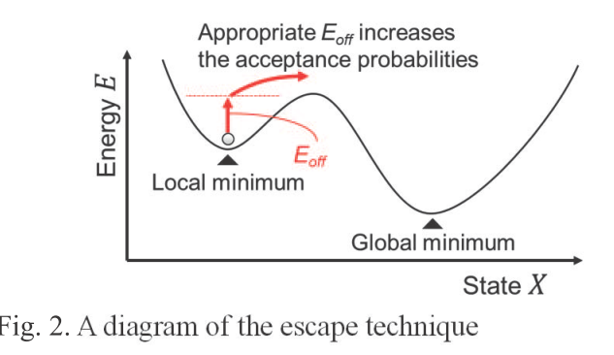
Escape technique from local minimum
The DA is equipped with a technique to reduce the time spent in a local minimum state.
If no bit flip candidate is found, the escape from a local minimum state is facilitated by adding the positive offset E_{off} to the energy.
Approximately equivalent to multiplying the common factor by the acceptance probability of a bit flip

Slide 13
Replica exchange method
In stochastic search, there are various speedup methods using multiple replicas defined as MCMC search processes specified by state variables and temperature.
One of the simplest methods is a simple parallel annealing
When the lowest energy state obtained by multiple replicas is used as a solution, the target accuracy rate of each search may be small. Therefore, the time required to obtain the lowest energy state can be expected to be shortened.

Slide 14
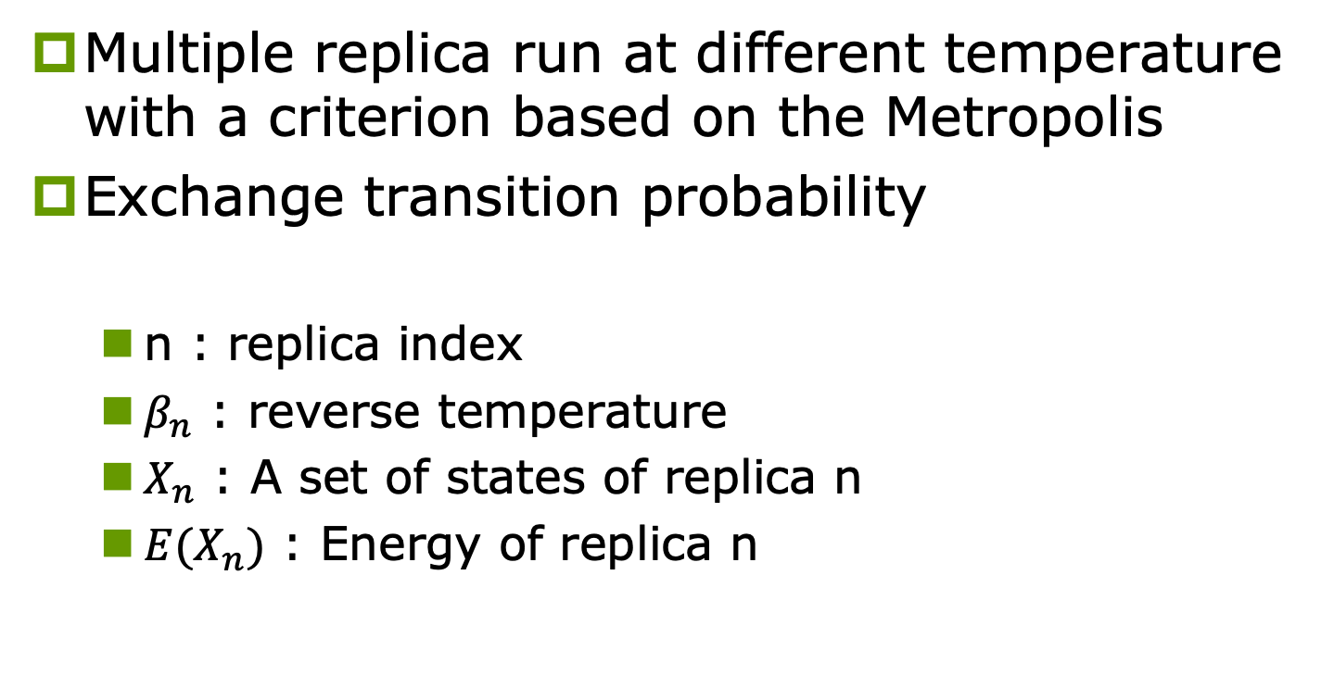
Replica exchange scheme (cont’d)
Multiple replica run at different temperature with a criterion based on the Metropolis
Exchange transition probability
n : replica index
$β_{n}$ : reverse temperature
$X_{n}$ : A set of states of replica n
${E(X}_{n})$ : Energy of replica n

Slide 15
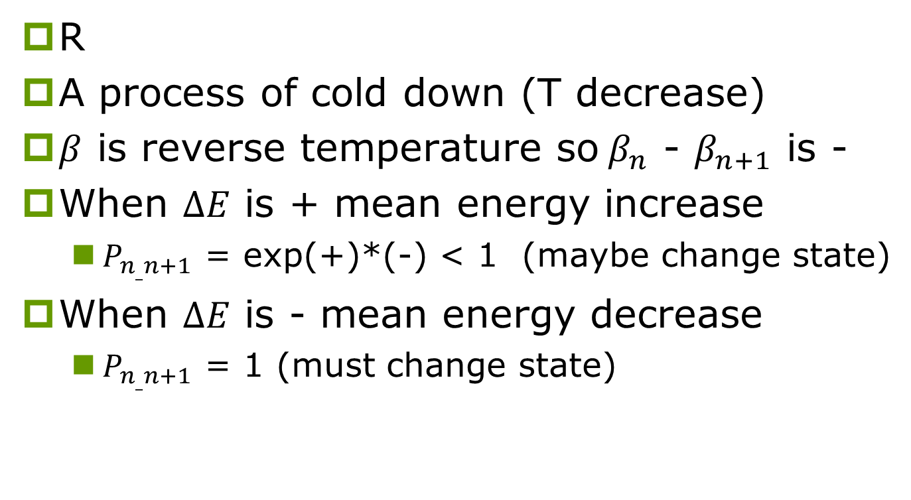
Replica exchange scheme (cont’d)
R
A process of cold down (T decrease)
$β$ is reverse temperature so$β_{n}$ - $β_{n+1}$ is -
When $∆E$ is + mean energy increase
$P_{n_{_}n+1}$ = exp(+)*(-) < 1 (maybe change state)
When $∆E$ is - mean energy decrease
$P_{n_{_}n+1}$ = 1 (must change state)

Slide 16
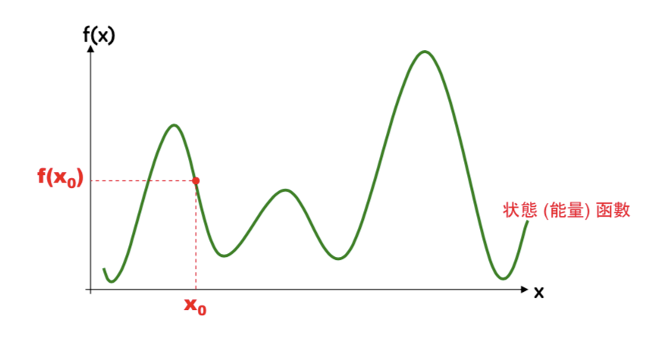
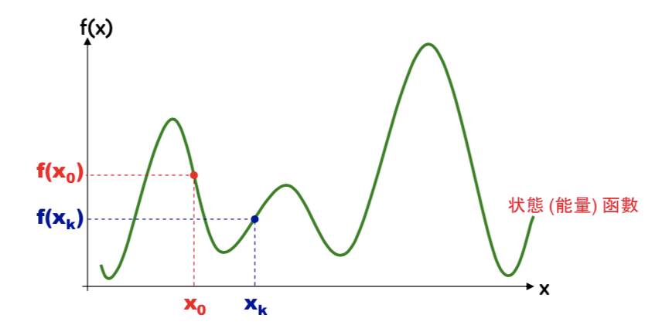
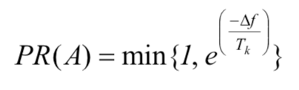



Replica exchange scheme (cont’d)
E(T)
R3
R8
R6
R2
R4
R7
R5
R1
T
Don’t need to find T
Find T is tricky

Slide 17
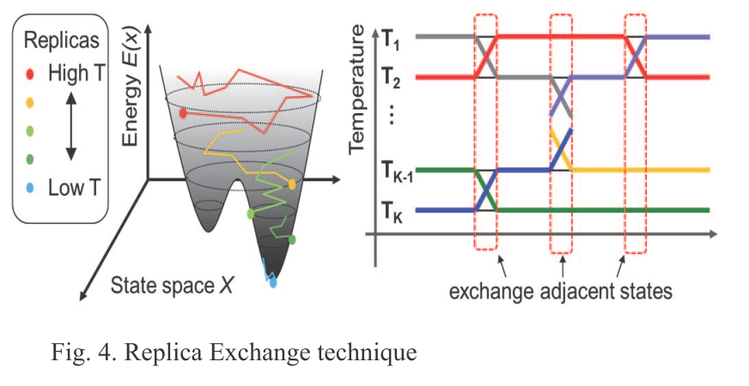
Replica exchange method(cond.)

Slide 18
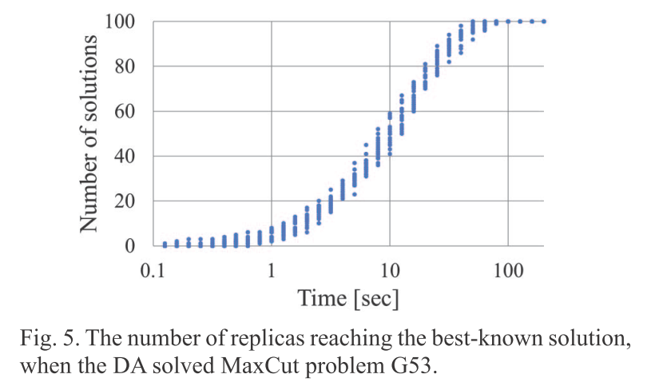
Behavior of solution search by DA
Figure 5 shows the experimental results of the number of replicas that reached the best-known solution over time, when the DA in the replica exchange mode solved a problem 20 times with different seeds of the random number.
The problem instance was G53 from Gset [10] which was a standard maximum cut problem (MaxCut) library. The number of replicas was 100. In the experimental results, the number of replicas that reached the best-known solution increased over time, with all of them eventually reaching it. This result shows that the behavior of the solution search by DA is almost independent of the seed, and the probability of reaching the optimal solution also increases over time.

Slide 19
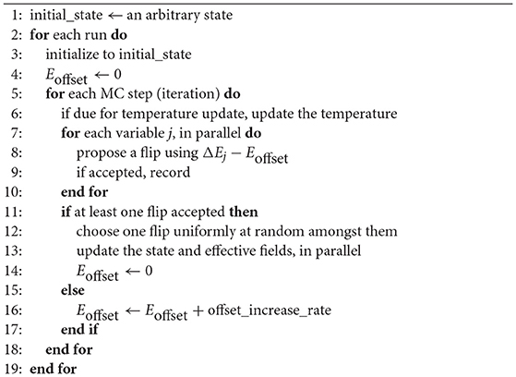
Algorithm

Slide 20
iII. EVALUATION RESULTS

Slide 21
Evaluation Results
Compared with the first generation, the DAU has been extended from 1,024 to 8,192 in bit scale and from 16 bits to a maximum of 64 bits in coupling resolution.
Problems:
MaxCut, MinCut, QAP
Solvers compare:
DAU, general-purpose solver CPLEX and a state-of-the-art dedicated solver for each problem

Slide 22
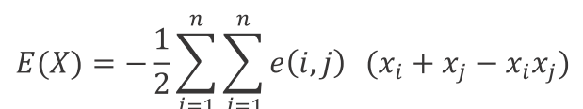
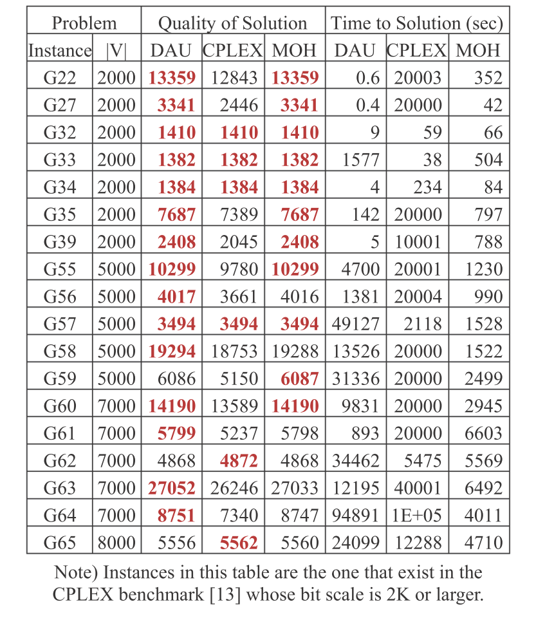
Maximum cut problem
Divides the vertices of an undirected graph into two subsets and maximizes the sum of the weights of the edges between the vertices belonging to different subsets.
MOH:a MaxCut dedicated algorithm developed by Ma and Hao
DAU reached the best-known solution in 62 of 65 instances

Slide 23
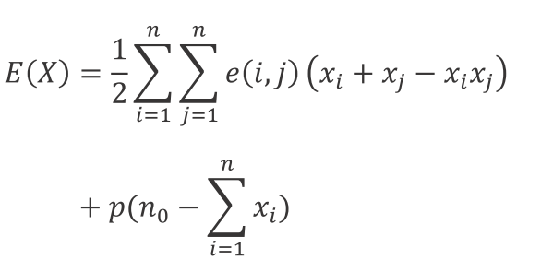
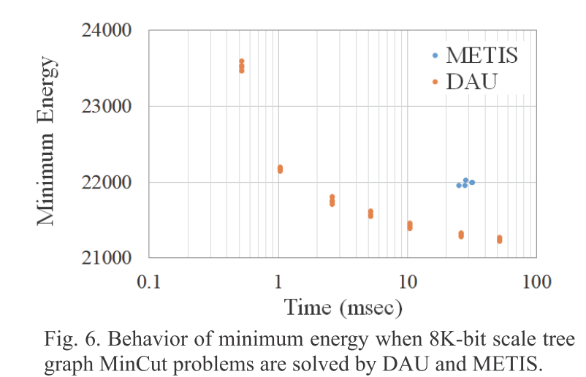
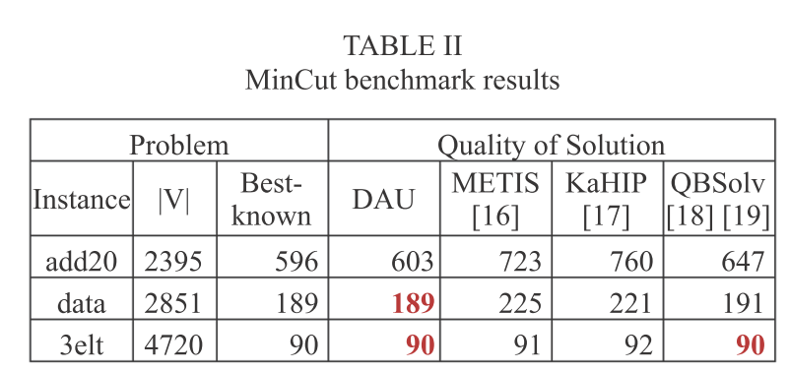
Minimum cut problem
Divides the vertices of an undirected graph into two equally sized subsets and minimizes the sum of the weights of the edges between the vertices belonging to different subsets.(Used in VLSI)
The execution time is limited to 60 seconds for the DAU
METIS is a set of highly evaluated serial programs for partitioning graphs. METIS using the multilevel recursive bisection paradigm ran on a single-core Xeon processor clocked at 3.6 GHz.
18 times faster
4.0% better than
that of METIS

Slide 24
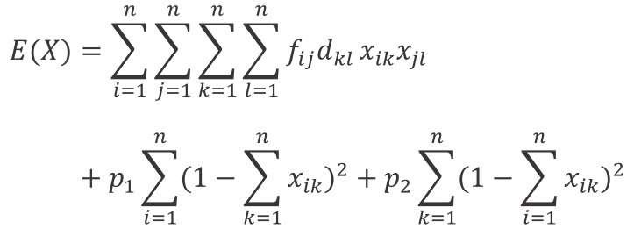
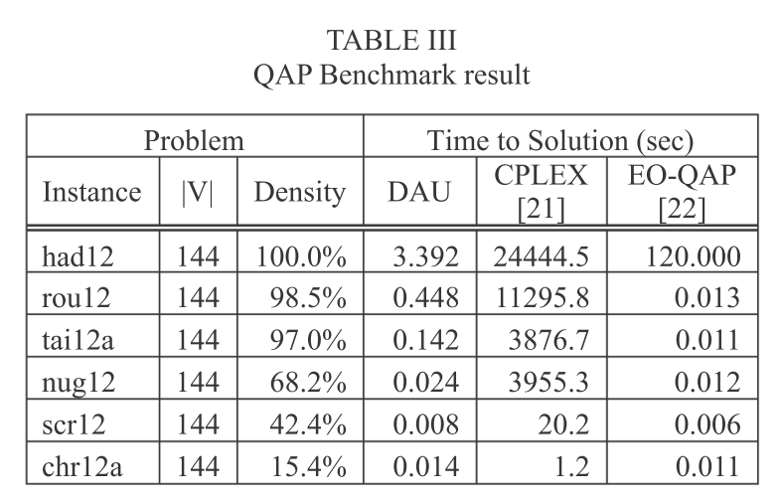
Quadratic assignment problem
QAP is the problem of minimizing the sum of the product of the amount of flow and distance for n factories and n locations, given the amount of flow and the distance between factories.
The quality of these solutions is the same because the three solvers including DAU, have reached the best-known solutions for all problem instances.

Slide 25
iV. APPLICATION EXAMPLES

Slide 26
Application to middle-molecule drug discovery
In the field of drug discovery, middle-molecular drugs with a molecular weight of about 500 ~ 2000 have recently attracted attention.
A structure in which a few dozen amino acids are linked in a chain
High target selectivity and fewer side effects
Here, they show an application example of the DA to a stable structure search for the middle-molecule drug candidate having 48- amino acids.

Slide 27
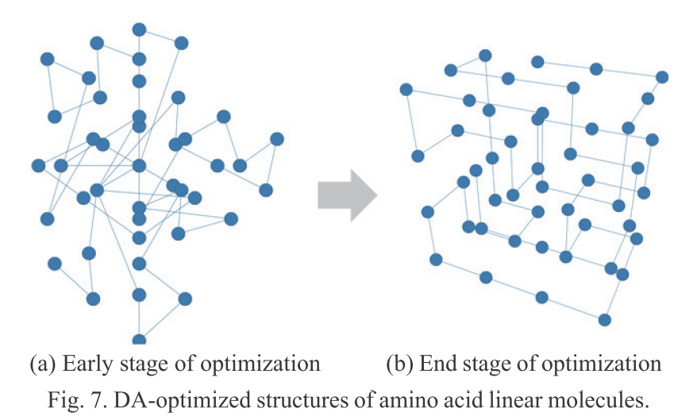
Application to middle-molecule drug discovery(cont.)
The linear molecular structure of amino acids is simplified by replacing one amino acid with one pseudo-atom, and the stable structure search based on the Lattice Protein Model is performed.
In the formulation, an about 31,000- bit scale is required for a 48-residue amino acid.
Larger than 8,192 in the DAU, they applied the software dividing technique.
Speedup of about 100 times
This result shows that the search time for the middle-molecule drug candidate, which takes about 6 months by the conventional method, can be shortened to several days.

Slide 28
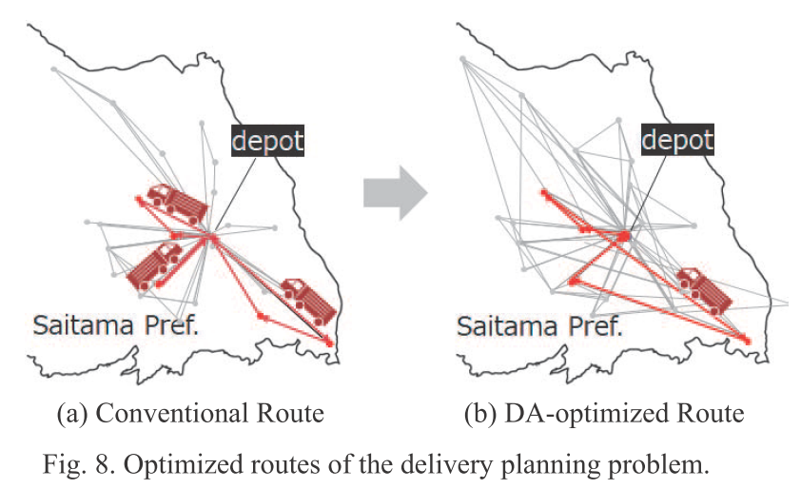
Application to delivery planning
The delivery planning problem is very difficult to solve
Various problems settings and constraints
An example of the transportation network optimization in a post office as an application of the DA to delivery planning.
A *QUANTUM (A STAR QUANTUM) in Japan Post's Open Innovation Program “POST LOGITECH INNOVATION PROGRAM 2018.”

Slide 29
Application to delivery planning (cont.)
The mandatory requirement for this problem is that trucks departing from the customer site load/unload at the pickup/delivery destination within a specified time range, and that the delivery demand of all the pickup/delivery destinations is satisfied.
Improves the loading ratio of trucks by 12%
Reduce the number of vehicles required to satisfy all the loads from 52 to 48
Reduce delivery cost by 7%

Slide 30
v. Conclusion

Slide 31
Conclusion
Overview of DAU
Multiple speed-enhancement techniques
the second-generation DA can handle problems up to 8,192-bit scale with fully coupled connectivity and high coupling resolution
Benchmark results revealed that the DA performed comparably or superiorly to the general-purpose solver CPLEX and the state-of-the-art dedicated solvers in terms of speed and solution quality.

Slide 32
Reference
[1]R. Colwell, “The Chip Design Game at the End of Moore's Law,” Hot Chips 27, 2015.
[2]https://www.dwavesys.com/press-releases/d-wave-previews-next- generation-quantum-computing-platform
[3]Paul. I. Bunyk, Emile M. Hoskinson, Mark W. Johnson, E. Tolkacheva, F. Altomare, Andrew. J. Berkley, R. Harris, Jelemy. P. Hilton, T. Lanting, Anthony J. Przybysz, and J. Whittaker, “Architectural Considerations in the Design of a Superconducting Quantum Annealing Processor,” IEEE Transactions on Applied Superconductivity, Vol. 24, p. 1, August, 2014.
[4]T. Takemoto, M. Hayashi, C. Yoshimura, and M. Yamaoka, “A 2×30k-Spin Multichip Scalable Annealing Processor Based on a Processing-In-Memory Approach for Solving Large-Scale Combinatorial Optimization Problems,” ISSCC, pp. 52–54, 2019.
[5]S. Kirkpatrick, C. D. Gelatt, Jr., and M. P. Vecchi, “Optimization by simulated annealing,” Science, New Series, Vol. 220, pp. 671- 680, May, 1983.
[6]T. Inagaki, Y. Haribara, K. Igarashi, T. Sonobe, S. Tamate, T. Honjo, A. Marandi, Peter. L. McMahon, T. Umeki, K. Enbutsu, O. Tadanaga, H. Takenouchi, K. Aihara, K. Kawarabayashi, K. Inoue, S. Utsunomiya, and H. Takesue, “A coherent Ising machine for 2000-node optimization problems,” Science 04 Nov 2016: Vol. 354, pp. 603-606, 2016.
[7]H. Goto, K. Tatsumura and A. R. Dixon, “Combinatorial optimization by simulating adiabatic bifurcations in nonlinear Hamiltonian systems,” Science Advances Vol. 5, eaav2372., 2019.
[8]https://www.fujitsu.com/digitalannealer/
[9]K. Hukushima and K. Nemoto, “Exchange Monte Carlo method and application to spin glass simulations,” Journal of the Physical Society of Japan, Vol. 65, pp. 1604-1608, June, 1996.
[10]http://www.stanford.edu/~yyye/yyye/Gset

Slide 33
Reference
[11] A. Lucas, “Ising formulations of many np problems,” Frontiers in Physics, Vol. 2, February, 2014.
[12] Fuda Ma and Jin-Kao Hao., “A multiple search operator heuristic for the Max-k-cut problem,” CoRR abs/1510.09156.
[13] T. Ikuta, H, Imai, and Y. Yano, Research Institute for Mathematical Sciences, Vol. 1941, pp. 49–56, 2015. (in Japanese).
[14] http://chriswalshaw.co.uk/partition
[15] H. Ushijima-Mwesigwa, Christian F. A. Negre, and Susan M. Mniszewski, “Graph Partitioning using Quantum Annealing on the D-Wave System,” arXiv:1705.03082, 2017.
[16] http://glaros.dtc.umn.edu/gkhome/metis/metis/overiew
[17] P. Sanders and C. Schulz, “Think locally, act globally, Highly balanced graph partitioning,” Proceedings of the 12th International Symposium on Experimental Algorithms, pp. 164- 175, October, 2012.
[18] Y. Wang, Z. Lu, F. Glover, and J. Hao, “Path Relinking for Unconstrained Binary Quadratic Programming,” European Journal of Operational Research, Vol. 223, pp.595-604, December, 2012.
[19] S. Feld, C. Roch, T. Gabor, C. Seidel, F. Neukart, I. Galter, W. Mauerer, and Claudia L. Popien, “A Hybrid Solution Method for the Capacitated Vehicle Routing Problem Using a Quantum Annealer,” Frontiers in ICT, Vol. 6, June, 2019.
[20] Eranda Cela, “The Quadratic Assignment Problem Theory and Algorithm”, Springer, NewYork,1998.
[21] Edward, K., “Performance Tuning for Cplex’s Spatial Branch- and-Bound Solver for Global Nonconvex (Mixed Integer) Quadratic Programs,” Informs optimization Society Meeting, 2017.
[22] Munera, D., Diaz, D., and Abreu, S., “Solving the Quadratic Assignment Problem with Cooperative Parallel Extremal Optimization,” the 16th European Conference on Evolutionary Computation in Combinatorial Optimization. Porto, 2016.

Slide 34
Reference
[23]http://anjos.mgi.polymtl.ca/qaplib/
[24]K. F. Lau and Ken A. Dill, “A lattice statistical mechanics model of the conformational and sequence spaces of proteins,” Macromolecules, Vol.22, No.10, pp.3986-3997, 1989.
[25]B. Maher, A. A. Albrecht, M. Loomes, X.-S. Yang and Kathleen Steinhöfel, “A firefly-inspired method for protein structure prediction in lattice models,” Biomolecules, Vol.4, pp.56-75, 2014.

Slide 35
THANK YOU

